Slide 1
AKSHA RUTH A
Final Project

Slide 2
OBJECT RECOGNITION USING CNN

Slide 3


AGENDA
PROBLEM STATEMENT
PROJECT OVERVIEW
WHO ARE THE END USERS?
YOUR SOLUTION AND ITS VALUE PROPOSITION
THE WOW IN YOUR SOLUTIONS
MODELLING
RESULTS
3/21/2024 Annual Review

Slide 4

PROBLEM STATEMENT
The task of object recognition involves the identification and classification of objects within images or video frames. With the advent of deep learning techniques, particularly Convolutional Neural Networks (CNNs), significant advancements have been made in the field of computer vision. However, the challenge persists in developing robust and accurate CNN models for object recognition across diverse datasets and real-world scenarios.

Slide 5

PROJECT OVERVIEW
This project endeavors to create a robust and efficient system for object recognition using convolutional neural networks (CNNs). By leveraging comprehensive datasets containing diverse object categories, the system aims to accurately identify objects within images across various contexts and environments. Through the implementation of state-of-the-art CNN architectures and advanced training techniques, the models will be trained to extract meaningful features and classify objects with high precision. Rigorous validation and testing procedures will ensure the reliability and generalization of the developed models. Upon successful development, the object recognition system will have diverse applications in fields such as autonomous vehicles, surveillance, medical imaging, and augmented reality, offering significant advancements in computer vision technology.

Slide 6

WHO ARE THE END USERS?
Manufacturing and Quality Control: Industries involved in manufacturing and quality control, such as automotive, electronics, and consumer goods, utilize object recognition systems to inspect products for defects, ensure quality standards, and automate production processes.
Retail and E-commerce: Retailers and e-commerce companies employ object recognition systems for inventory management, product categorization, recommendation systems, and customer experience enhancements, such as visual search and augmented reality applications.

Slide 7
3.Security and Surveillance: Law enforcement agencies, security firms, and public safety organizations use object recognition systems for video surveillance, facial recognition, object tracking, and anomaly detection to enhance security and prevent crime.
4.Autonomous Vehicles: Automotive companies and technology firms developing autonomous vehicles rely on object recognition systems for perception tasks, including detecting pedestrians, vehicles, road signs, and obstacles, to enable safe and efficient navigation.
5.Healthcare and Medical Imaging: Healthcare providers and medical researchers utilize object recognition systems for medical imaging analysis, disease diagnosis, anatomical structure detection, and treatment planning in fields such as radiology, pathology, and ophthalmology.
6.Environmental Monitoring: Environmental agencies and organizations employ object recognition systems for monitoring and analyzing environmental data, including wildlife tracking, biodiversity assessment, and habitat conservation efforts.

Slide 8

YOUR SOLUTION AND ITS VALUE PROPOSITION
Automation and Efficiency: The Object Recognition System automates the process of object identification, enabling businesses to streamline operations, reduce manual effort, and improve overall efficiency in tasks such as quality control, inventory management, and surveillance.
Enhanced Decision-Making: By providing accurate and timely object recognition capabilities, the system empowers decision-makers to gain insights into their operations, make informed choices, and optimize resource allocation for improved outcomes.

Slide 9
3.Improved Customer Experience: In retail and e-commerce, the system enhances the customer experience by enabling personalized recommendations, visual search functionality, and augmented reality experiences, leading to increased customer satisfaction and loyalty.
4.Safety and Security: In security and surveillance applications, the system enhances safety and security by detecting and tracking objects of interest, identifying potential threats, and triggering appropriate responses to mitigate risks in real-time.
5.Optimization of Autonomous Systems: In autonomous vehicles and robotics, the system plays a critical role in perception tasks, enabling vehicles and machines to navigate safely, avoid obstacles, and interact with their environment effectively.
6.Scalability and Adaptability: The Object Recognition System is highly scalable and adaptable, capable of handling diverse object categories, varying environmental conditions, and evolving business requirements across different industries and applications.

Slide 10

THE WOW IN YOUR SOLUTION
Cutting-edge Technology: Our object recognition solution utilizes cutting-edge machine learning algorithms, particularly convolutional neural networks (CNNs), to achieve unparalleled accuracy and efficiency in identifying objects within images or video streams.
Real-time Processing: With lightning-fast processing capabilities, our solution can analyze vast amounts of visual data in real-time, enabling swift decision-making and response in dynamic environments such as manufacturing, retail, and security.
Versatile Applications: From manufacturing quality control to retail inventory management and autonomous vehicle navigation, our solution offers versatile applications across diverse industries, revolutionizing processes and enhancing productivity.
10

Slide 11
4.Enhanced Safety and Security: In security and surveillance applications, our solution enhances safety and security by detecting and tracking objects of interest, identifying potential threats, and triggering appropriate responses to mitigate risks effectively.
5.Intuitive User Experience: Featuring a user-friendly interface and seamless integration with existing systems, our solution empowers users of all technical backgrounds to harness the power of object recognition technology effortlessly.

Slide 12
MODELLING
Data Collection and Preprocessing:
Gather a diverse dataset of images containing various objects to be recognized.
Annotate the images with labels indicating the presence of specific objects.
Preprocess the images by resizing, normalizing, and augmenting to improve model generalization and performance.
Model Selection:
Choose an appropriate machine learning algorithm or deep learning architecture for object recognition.
Convolutional Neural Networks (CNNs) are commonly used due to their effectiveness in image classification tasks.
12

Slide 13
3.Model Architecture Design:
Design the architecture of the CNN model, considering factors such as depth, width, and complexity.
Experiment with different architectures such as VGG, ResNet, Inception, or custom-designed architectures to find the optimal model for the task.
4.Training:
Split the dataset into training, validation, and test sets.
Train the CNN model using the training data, optimizing the model parameters to minimize a defined loss function (e.g., cross-entropy loss).
Validate the model's performance on the validation set, monitoring metrics such as accuracy, precision, recall, and F1-score.
5.Evaluation and Fine-tuning:
Evaluate the trained model on the test set to assess its generalization ability and performance on unseen data.
Fine-tune the model by adjusting hyperparameters (e.g., learning rate, batch size) and architectural parameters based on performance feedback from the validation set.

Slide 14
RESULTS
Accuracy: The proportion of correctly classified instances among all instances in the test dataset. It provides an overall measure of the model's correctness in identifying objects.
Precision: The proportion of correctly identified positive cases (true positives) among all instances predicted as positive (true positives + false positives). It measures the model's ability to avoid false positives.
Recall (Sensitivity): The proportion of correctly identified positive cases (true positives) among all actual positive cases (true positives + false negatives). It measures the model's ability to detect all instances of objects.
14

Slide 15
4.Confusion Matrix: A matrix that summarizes the performance of a classification model, showing the number of true positives, false positives, true negatives, and false negatives.
5.ROC Curve and AUC Score: The Receiver Operating Characteristic (ROC) curve plots the true positive rate against the false positive rate at various threshold settings. The Area Under the ROC Curve (AUC) score provides a single measure of the model's discriminative ability.
6.Mean Average Precision (MAP): A metric commonly used in object detection tasks, representing the average precision across all classes. It is particularly relevant when there are multiple object classes to be detected.

Slide 16
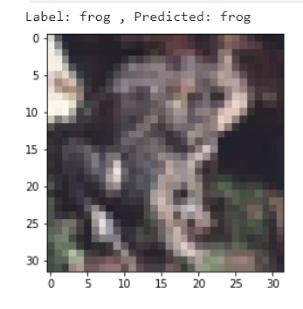
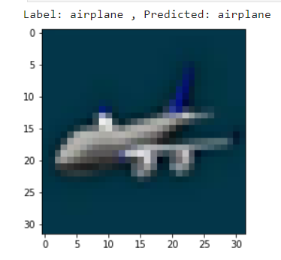
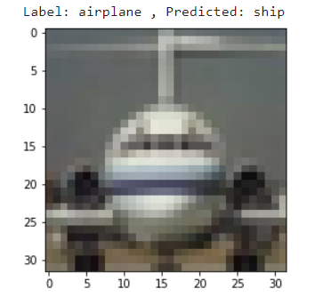
CORRECTLY PREDICTED OBJECT
MISCORRECTLY PREDICTED OBJECT

